Slide 1

SAP Analytics cloud training
Anurag Bajaj
Shubham Singh
Day 12

Slide 2
Agenda – Day 13
Connections Basics
Introduction to Connections
Cloud Connector
Connecting to Import data with BW
Connecting to S/4HANA System
www.anubhavtrainings.com

Slide 3


Connections
Acquired Data
Connection
Connection with Real system but SAC will fetch all the data and load it in itself
All the data will be stored securely in SAC, but the data security is subjected to SAC
Data needs to be updated timely basis using update jobs
New data is available in SAC near Real-time
All the smart features are supported on Acquired data
E.g. Google drive, S/4HANA Connection, BW, BPC, DowJons, …
Live Data Connection
Data is NEVER replicated in SAC but only the skeleton/structure of the data is stored in SAC (metadata)
When the stories are executed, data will be
loaded at runtime from the target system
Data Security, roles, constraints will be the duty of source system. Data is always real-time
We can reuse existing assets like CDS, Bex, InfoProviders, Universe
Little performance lag
www.anubhavtrainings.com

Slide 4

How Connection Works
Intranet
Connection
In.A
SAP Analytics Cloud
SCC
Source System On-prem
SAC Analytic Agent
Connection
Adaptor
Source System
On-prem (AWS)
ABAP
SAP HANA
www.anubhavtrainings.com

Slide 5
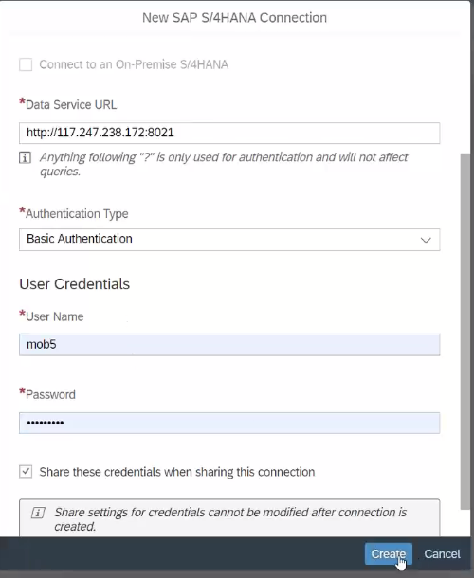
Acquired Data Connection
Service URL get from our S/4HANA System
Assign Basic Authentication
Credentials of our S/4HANA System
www.anubhavtrainings.com

Slide 6
Live Data Conn. With SAP HANA DB in Cloud
SAP Analytics Cloud
(Client)
HANA Consultants
SAP HANA Service
Adaptor
MTA App
www.anubhavtrainings.com

Slide 7
OData Connection
ODataConnection.executeAction("Flight/Book",{
Flight: {
Airline: 'AA',
Flightconnection: '0017',
Flightdate: FLDate
},
NumberOfSeats: 1
});
Application.refreshData();
ODataConnection.executeAction("CancelMyFlights",{
DateFrom: '2020-01-01',
DateTo: '2022-01-01'
});
Application.refreshData();
www.anubhavtrainings.com

Slide 8
HANA Live Integration with SAC
HANA Native Development (HANA Consultant – SAP WebIDE for HANA Dev)
HANA Instance needs to be started in SCP
Connect to WebIDE, create a new HANA DB Module
Maintain the service-name as some name inside the mta.yml → sac-hdi
Go to SRC folder inside DB folder and create
A DB table, - an csv file - an hditable - calculation view of type CUBE
Build the module and check the container
2. HANA Adaptor for secure connection to container in HANA (SAP Business App Studio)
Create a new dev workspace
Open workspace projects
Open terminal and type command npm install generator-anubhav-sac
Call yo command and provide container name from step 1 and SAC host url w/o http upto .sap
You will see a project created in bas, navigate to srv/target folder of that project
www.anubhavtrainings.com

Slide 9
Continue….
Go to sap tools for hana and download the xsahaa-release-1.6.1-release.zip (sha1)
Extract in computer and upload the war file to the folder
Right click to mta.yml file in the adaptor project and click Build MTA
If the build is success we see an mta_archieve with mtar extension.
Right click on MTAR file generated by system and say deploy to CF
Go to CF and Applications inside your dev space
Ideally an app with same name must be up and running
Once the app is deployed, we need to grant auth to our user to access this app
Go to role collection in our trial a/c search for app_Viewer role collection
Click and edit and assign to your email id and Save
Test the adaptor service by adding /sap/bc/ina/service/v2/HeartBeat
3. SAC Live Connection
Add live data connection with HANA of Direct Type
Provide Adaptor URL and enter CF credentials.
www.anubhavtrainings.com

Slide 10
End of Day 12

Slide 12

Questions

Slide 13

Anurag Bajaj
anurag.bajaj02@gmail.com

